Slide 1
U.S. Domestic Flight Price Identification
Ironhack Final Project
by Harrison Teeter
Fall 2023

Slide 2

Research Question
How accurately can one predict the relative price of airfare based on oil prices and location of airport from which one flies out?

Slide 3
Notes about Data
Advisory about flight prices: average fares are based on domestic itinerary fares, round-trip or one-way for which no return is purchased. Fares are based on the total ticket value which consists of the price charged by the airlines plus any additional taxes and fees levied by an outside entity at the time of purchase. Fares include only the price paid at the time of the ticket purchase and do not include other fees, such as baggage fees, paid at the airport or onboard the aircraft. Averages do not include frequent-flyer or 'zero fares' or a few abnormally high reported fares. Airports ranked by U.S. originating domestic passengers in 2022.
Source: Bureau of Transportation Statistics, Airline Origin & Destination Survey (10% Sample), DB1B_Ticket where bulk fare equals zero, itinerary fare is greater than or equal to fifty dollars ($50) and itinerary yield is less than or equal to three dollars ($3).

Slide 4
Limitations of Data
Data are only a sampling of all flight purchases that are either one-way or round-trip, which causes the prices to vary widely.
Data also do not take into account at which point the flights were purchased prior to the departure date.

Slide 5
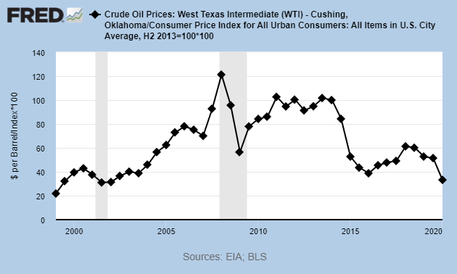
U.S. Oil Prices per Barrel (USD)

Slide 6
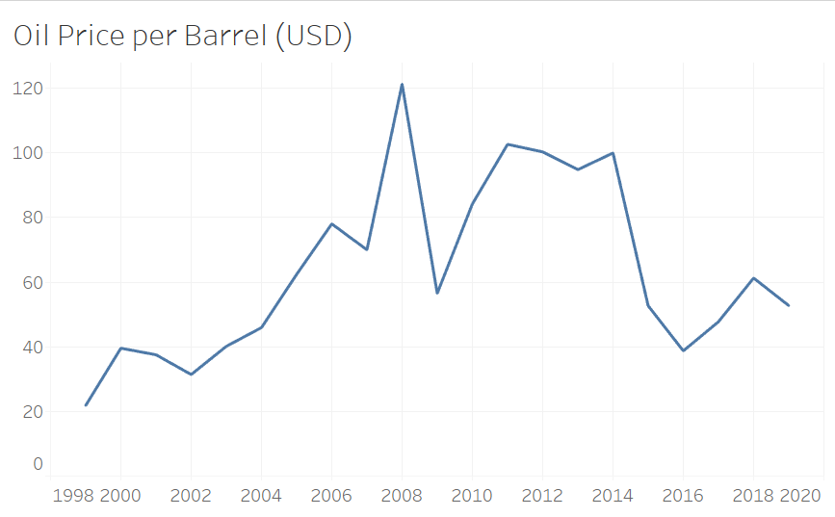
U.S. Oil Prices per Barrel (USD)

Slide 7
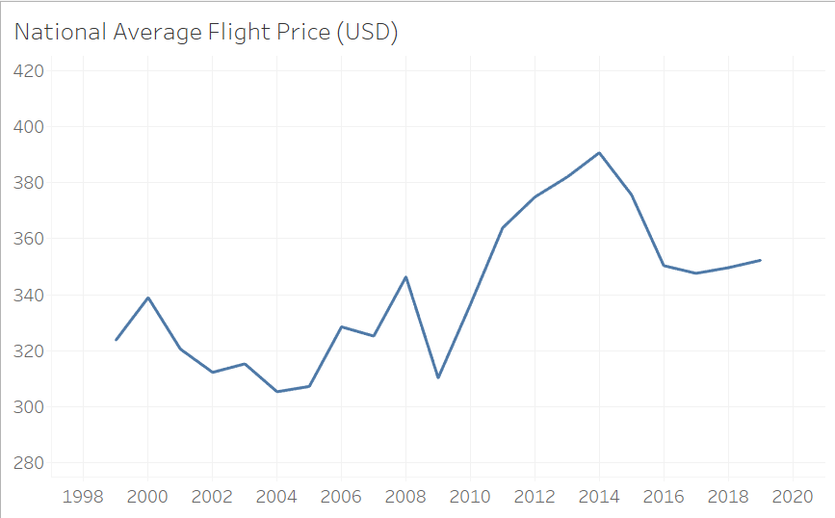
Airfare National Averages

Slide 8

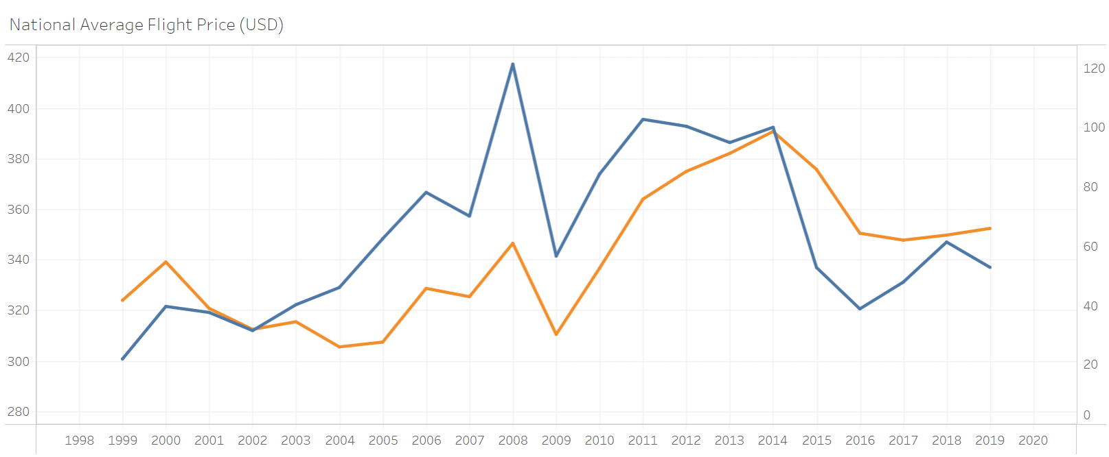
Visible Correlation

Slide 9
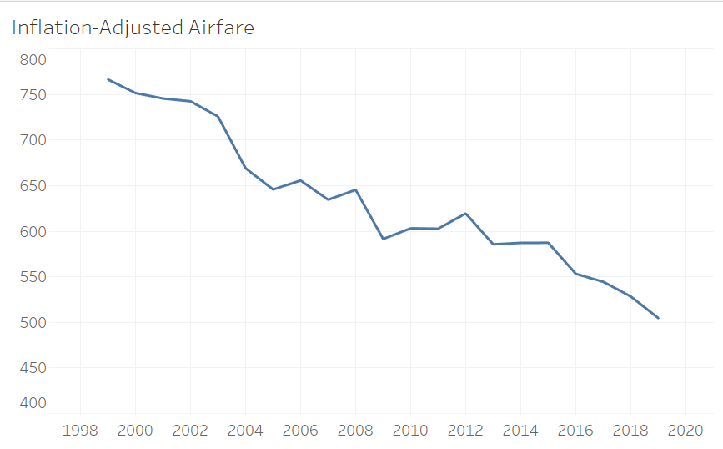
Inflation-adjusted Airfare

Slide 10
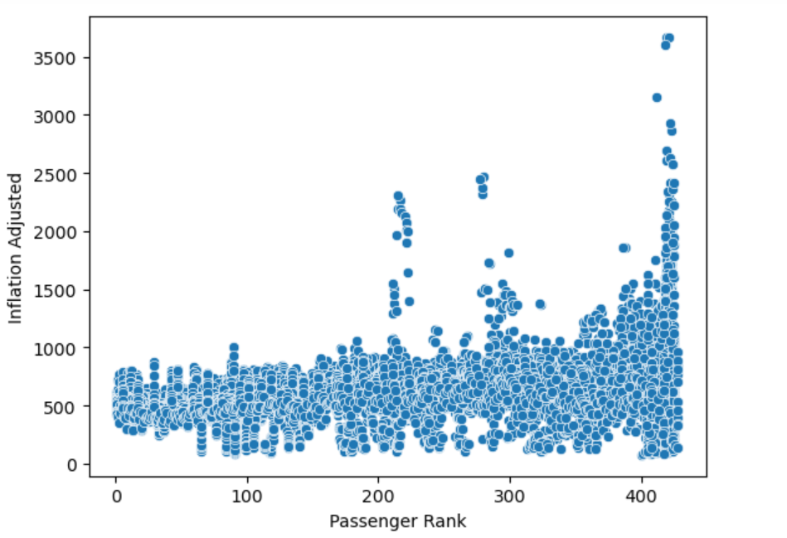
Location, location, location

Slide 11
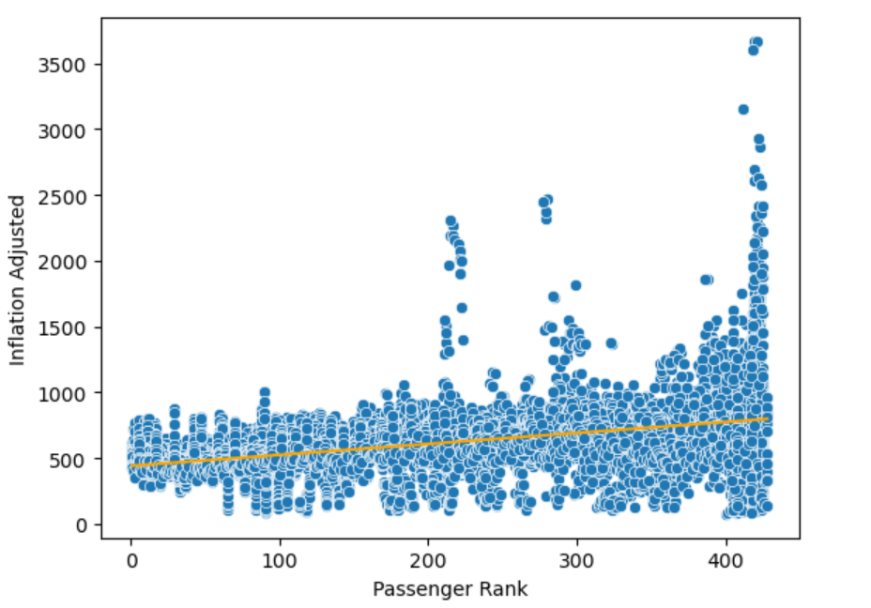
Location, location, location

Slide 12



Locations w/ highest airfares
Guam
Trust Territories
Alaska
Northern Mariana Islands
Marshall Islands, Palau
Federated States of Micronesia

Slide 13
Expansion Potential
Dream for project would be to enter information such as oil price, airport location, airline, etc. & yield reasonable results

Slide 14
Important fact to remember:
one cannot predict the future!

Slide 15
Questions?

Slide 16
Sources
Federal Reserve Bank of St. Louis
Bureau of Transportation Statistics
U.S. Energy Information Administration
Wikipedia (not applied)

